Slide 1
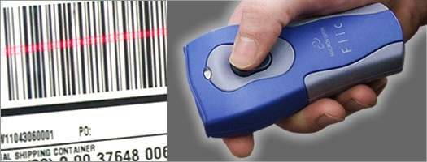
Inventory Management and Bar-code Implementation
Presentation Title Goes Here …presentation subtitle.
Submitted To:
Er.Rajbir Singh Cheema
(H.O.D of IT)
Submitted by:
Harminder kaur(100470825389)
Navdeep kaur(100470825404)

Slide 2
Barcode Inventory Management System
Generate Barcodes & Print Barcodes
Apply barcode on IN or OUT items
Take snapshot by Camera
Scan barcodes on IN OUT and match records

Slide 3
Generating & Printing barcode
Unique barcode for each Item
Image of item is scanned and stored
Print Barcode and attach on item

Slide 4

Types of Inventories (Cont’d)
Replacement parts, tools, & supplies
Goods-in-transit to Department or customers

Slide 5

Challenge??
‹#›

Slide 6
The Problems
Detailed study of Inventory model is required
Inventory movement is monitored and tracked

Slide 7
The Problems
To help security staff to easily locate inventory
To stop fraud
To smoothly transfer ownership of products.

Slide 8
Computerized Management
‹#›

Slide 9
Effective Inventory Management
A system to keep track of inventory
Easy Management
Knowledge of product location
A classification system

Slide 10
Basic Inventory Management Problems
Manual Entry Required
Time consuming
No location track
Not easy to search Information
‹#›

Slide 11
Unique Feature
Universal Bar Code - Bar code printed on a label that has information about the item to which it is attached
0
214800 232087768

Slide 12
Unique Feature
One time information entry is required. Then for any operation we have to just scan
0
214800 232087768

Slide 13






Barcode basics: Type of barcodes
1D barcode
UPC
Code 39
Code 128
etc
2D barcode
PDF 417
MaxiCode
etc
‹#›

Slide 14
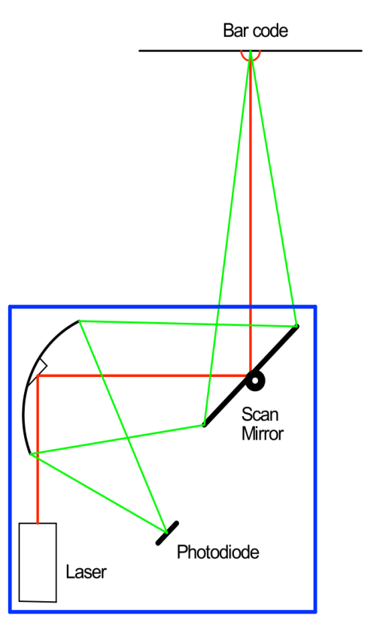

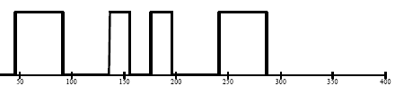
How a laser scanner works
A laser spot is scanned across the bar code symbol that is to be read.
The light reflected from the symbol is directed to a photodiode where it is converted from optical energy to electrical current.
The signal is processed through both hardware and software, and the information it carries is extracted.
Signal Processing: Hardware and Software
‹#›

Slide 15
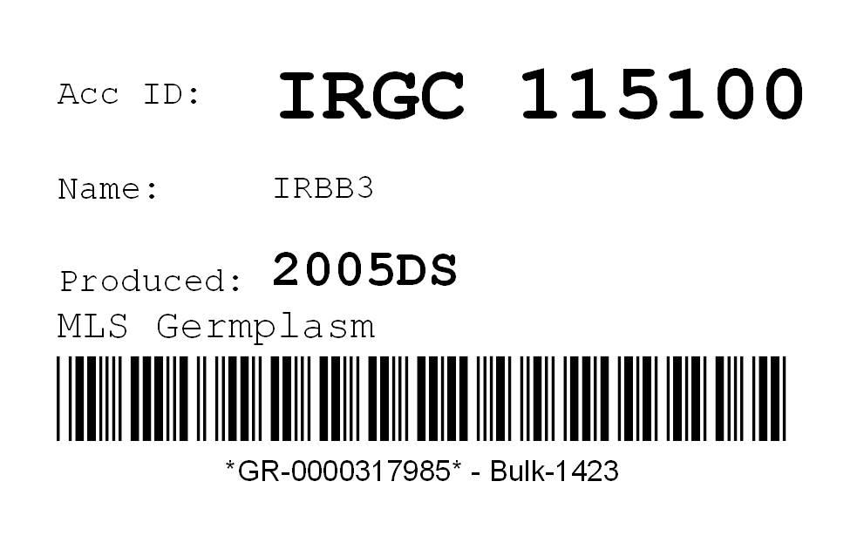
Barcode Label
‹#›

Slide 16
Summary
Barcode system are much efficient and make the whole management a lot simpler.
‹#›

Slide 17
Technologies Used
Advance JAVA (J2EE)(Servlets, Jquery, JavaScript)
Mysql:- Online Server Databases
Sqlite :-Local database for mobile Application
Apache Tomcat Server to run web-Application locally
Barcode Scanners
‹#›

Slide 18
Mobile Application
A mobile application can be used instead of Barcode Scanner for remote barcode scanning
‹#›

Slide 19
Snapshots
‹#›

Slide 20
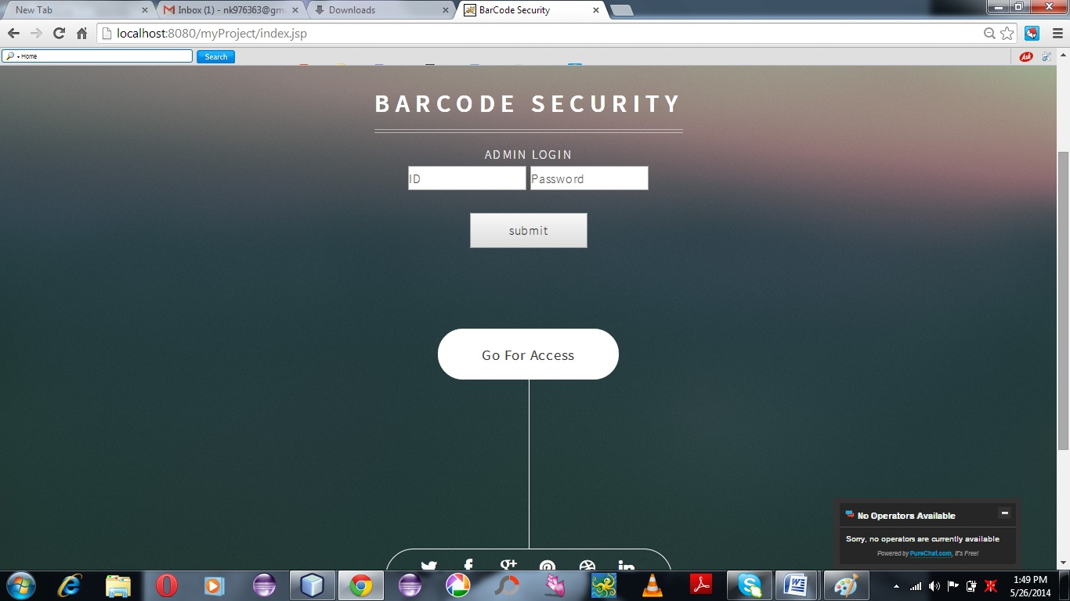

‹#›

Slide 21
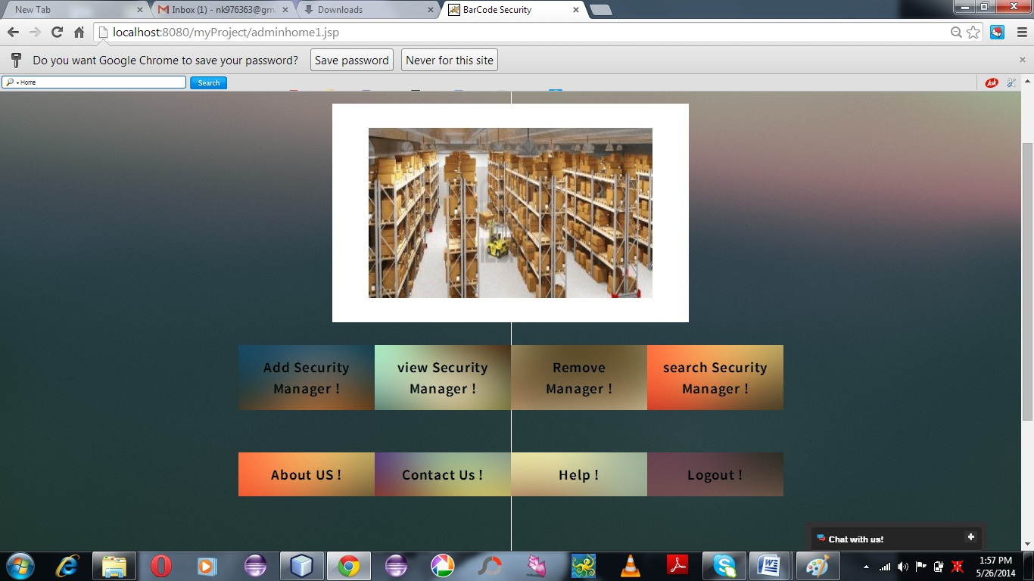
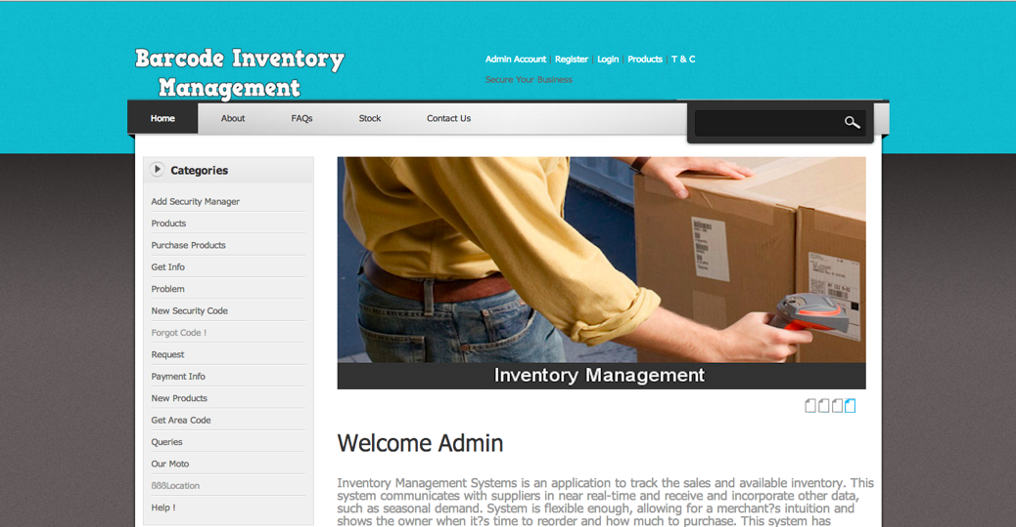

Slide 22
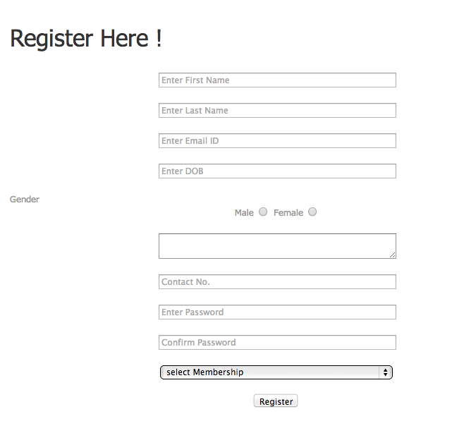
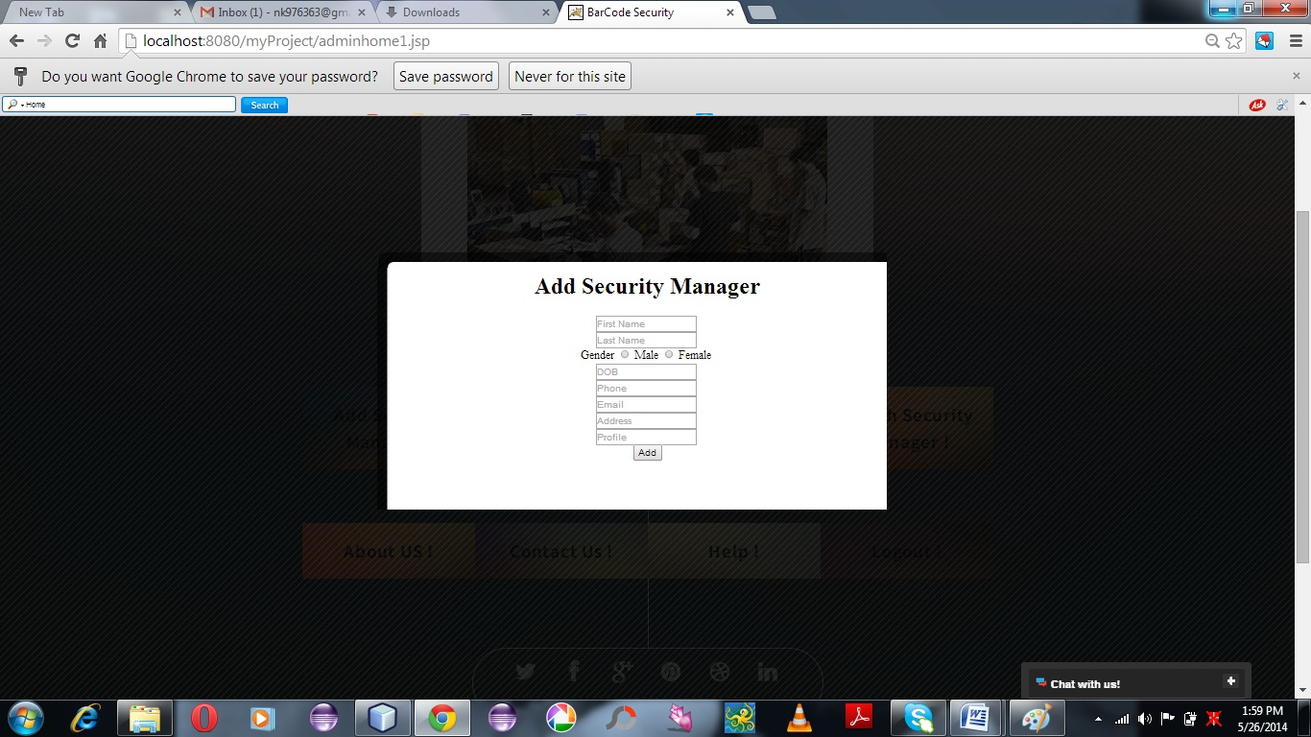

Slide 23
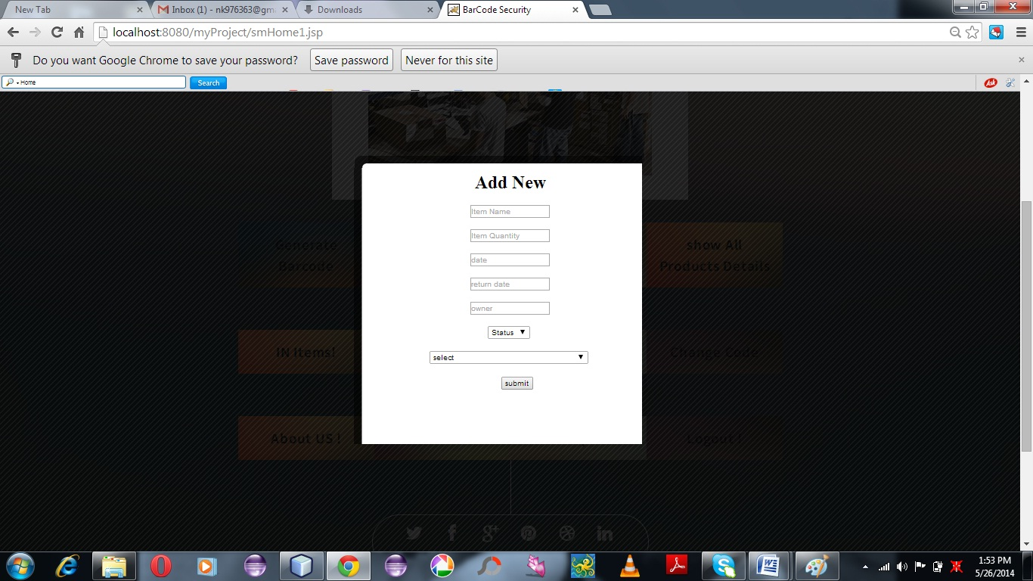
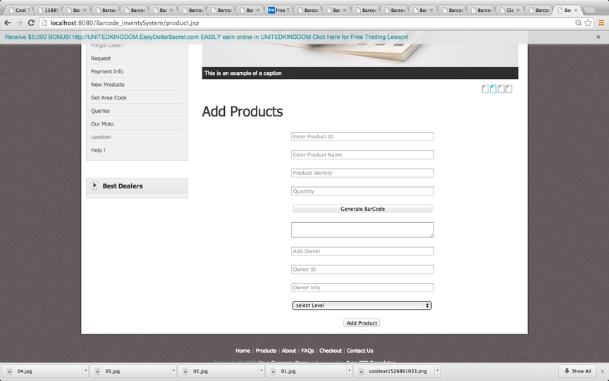

Slide 24

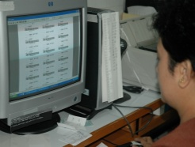

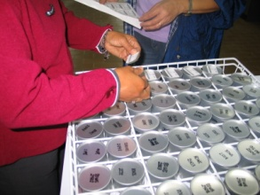
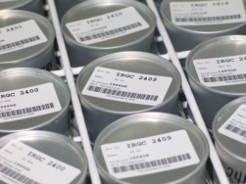
Thank you
Presentation Title Goes Here …presentation subtitle.

